Slide 1
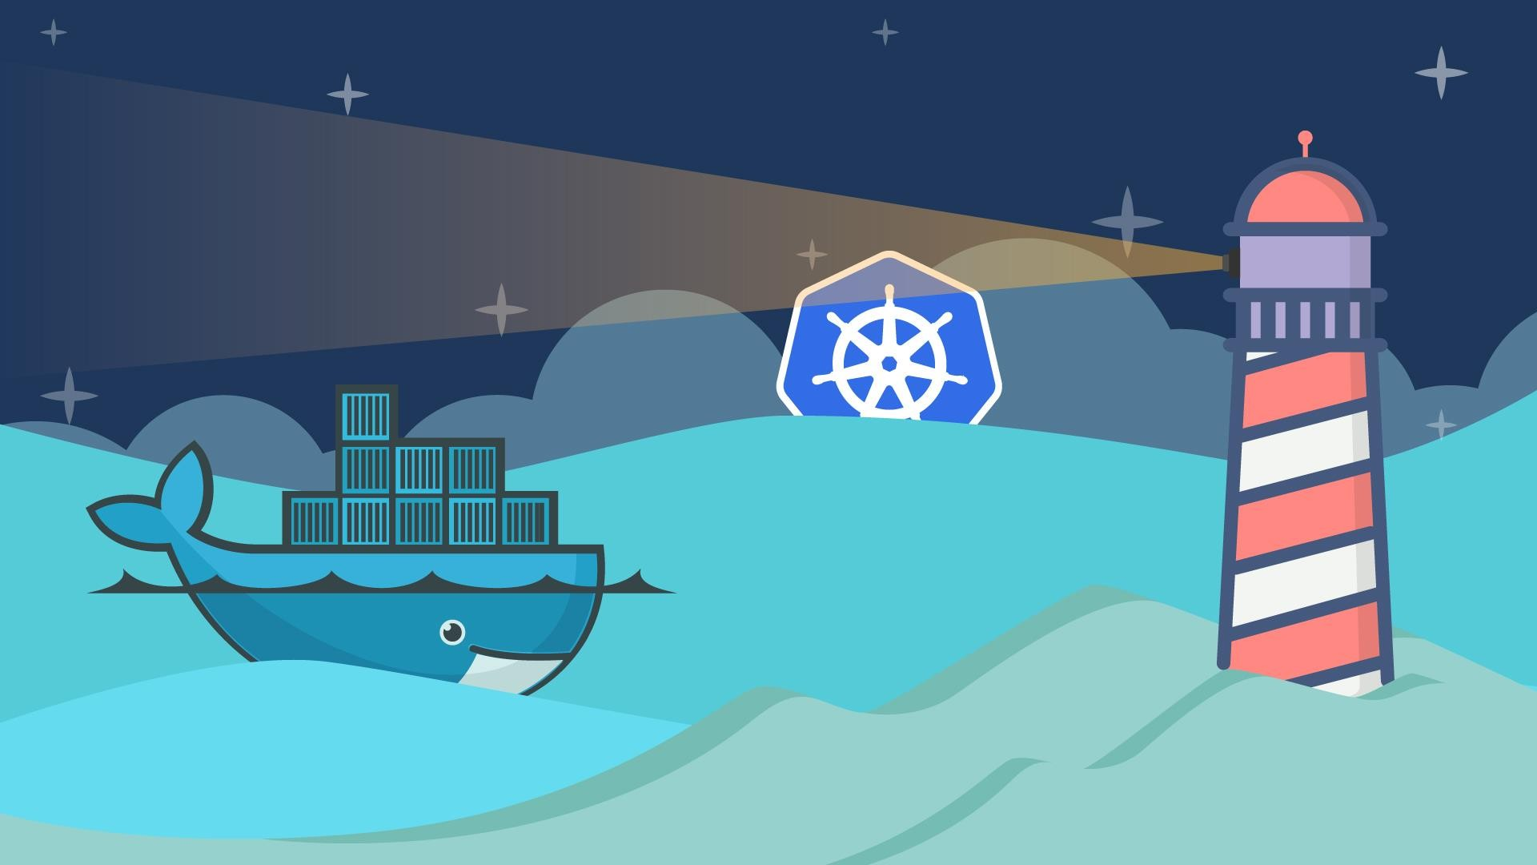
Introduction to
Docker

Slide 2
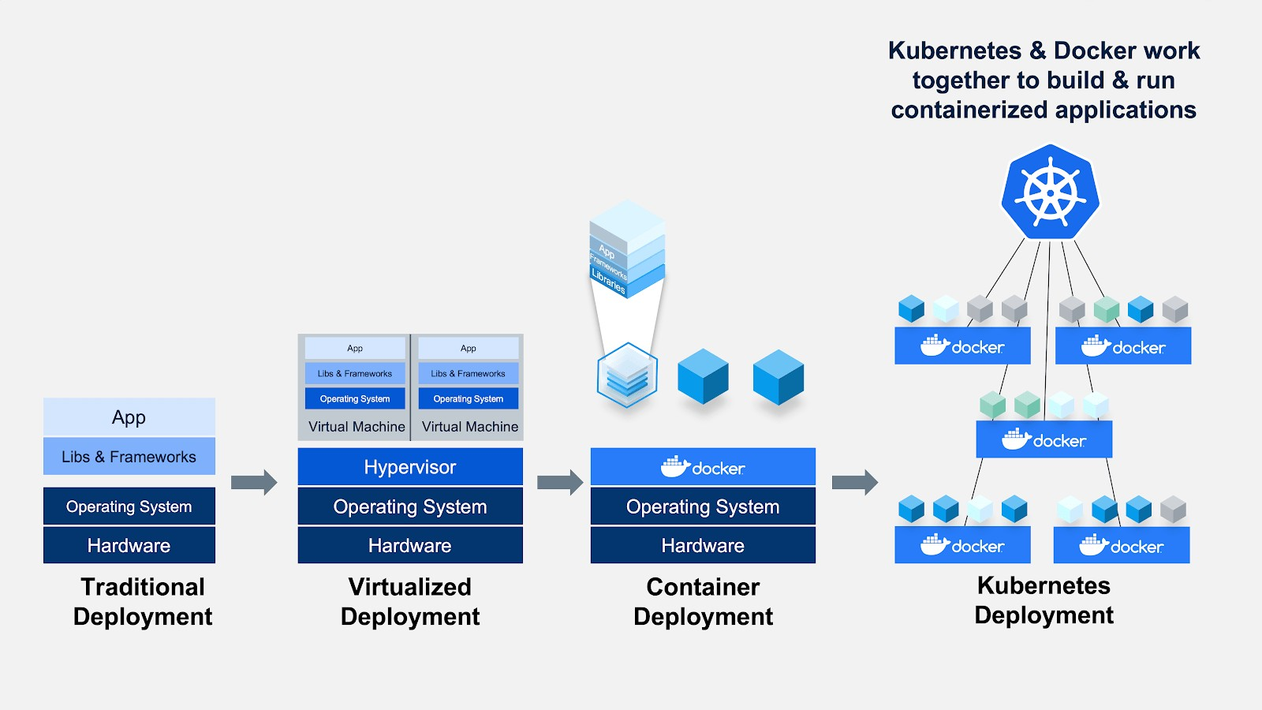


The past and the present of Apps Deployment
Kubernetes
https://www.edureka.co/blog/kubernetes-architecture/

Slide 3

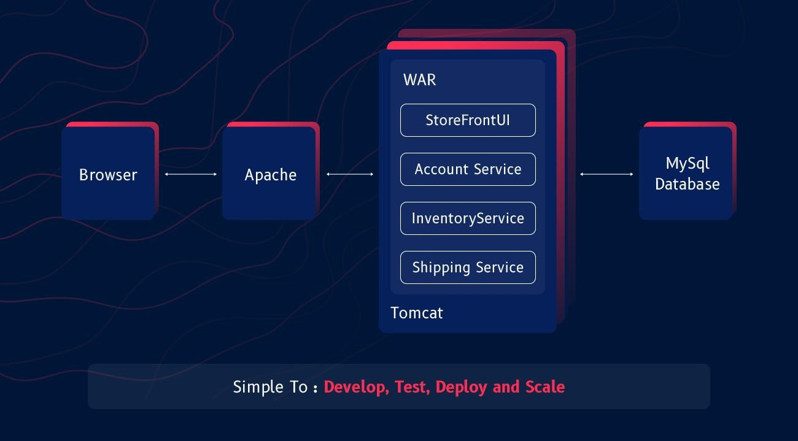
Monolithic Architecture

Slide 4
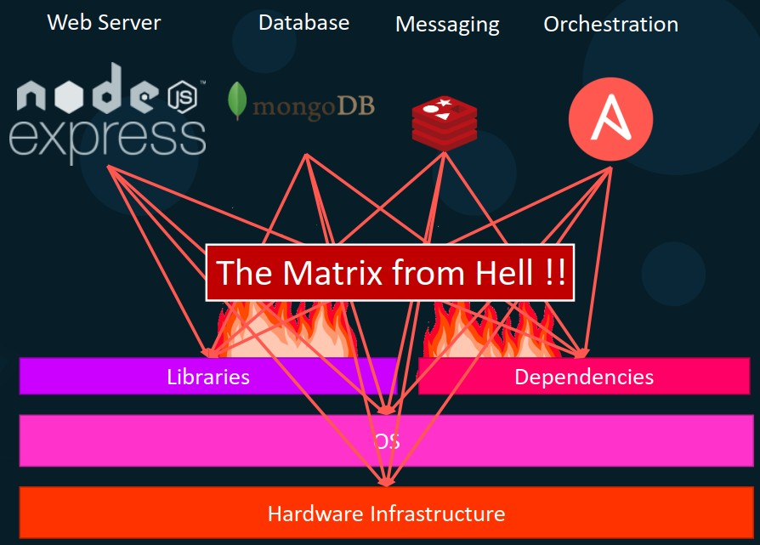
Monolithic Architecture
Different dependency requirements for each service
Long setup times
Different Dev/Test/Prod environments

Slide 5
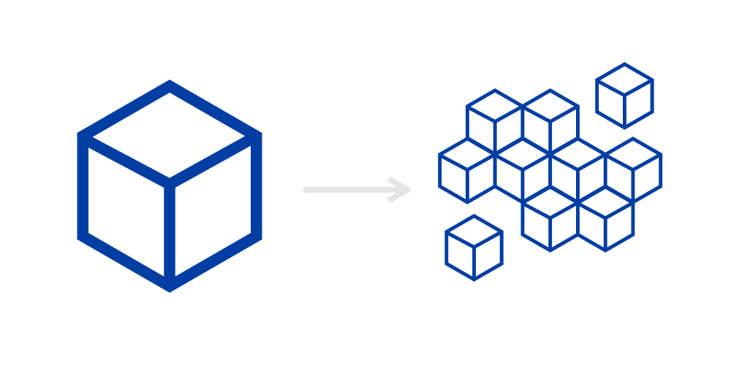
Monolithic Applications
Pros
Cons
Simple to develop
Simple to deploy – one binary
Easy Debugging & Error tracing
Simple to test
Less Costly
Difficult to understand and modify
Tightly coupled
Higher start-up and load times
Redeploy the entire application on each update, and
also continuous deployment is difficult
Less reliable: A single bug can bring down the entire application.
Scaling the application is difficult
Difficult to adopt new and advanced technology: Since changes in frameworks or languages will affect an entire application
Changes are one section of the code can cause an
unanticipated impact on the rest of the code
https://www.systango.com/blog/what-should-a-startup-choose-monolith-or-microservices-architecture/

Slide 6
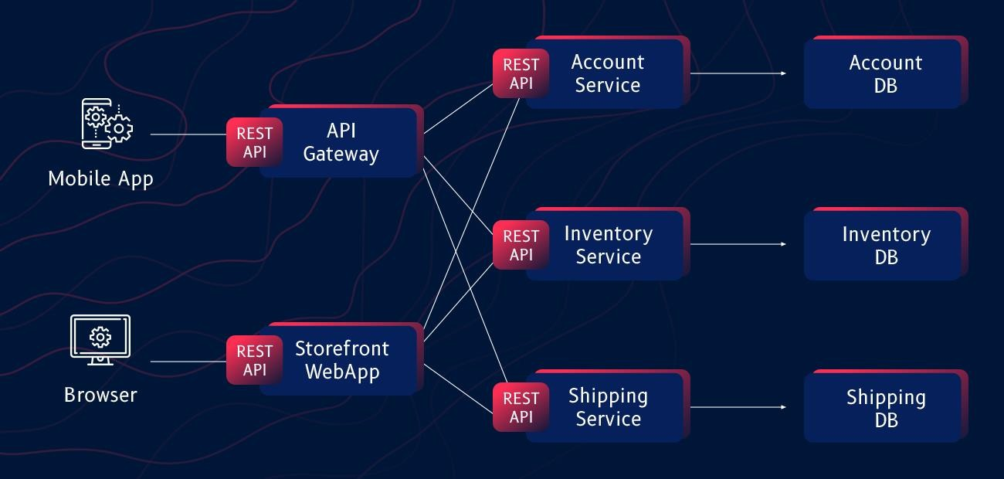
Microservices Architecture

Slide 7
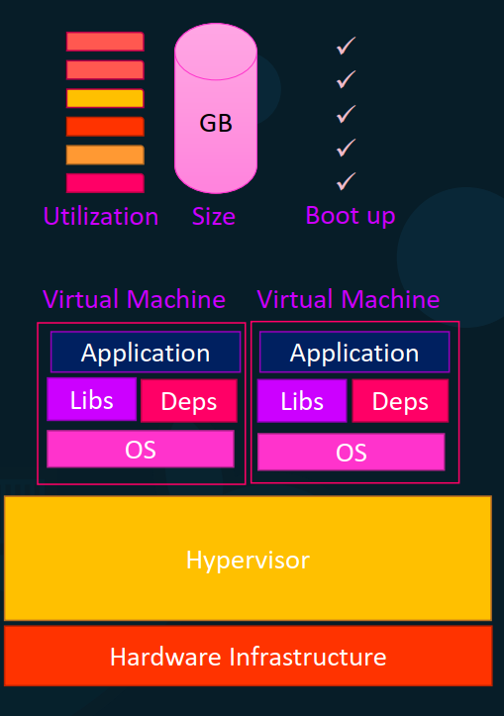
Microservices on VMs
Hypervisor
A hypervisor is software that creates and runs virtual machines (VMs) also known as guests.
It isolates the hypervisor operating system and resources from the virtual machines and enables the creation and management of those VMs.
The hypervisor treats host resources—like CPU, memory, and storage—as a pool that can be easily reallocated between existing guests or to new virtual machines.
Generally, there are two types of hypervisors.
Type 1 hypervisors, called “bare metal,” run directly on the host’s hardware. Ex: Microsoft Hyper-V or VMware ESXi hypervisor
Type 2 hypervisors, called “hosted,” run as a software layer
on an operating system. Ex: VirtualBox, VMware Player

Slide 8
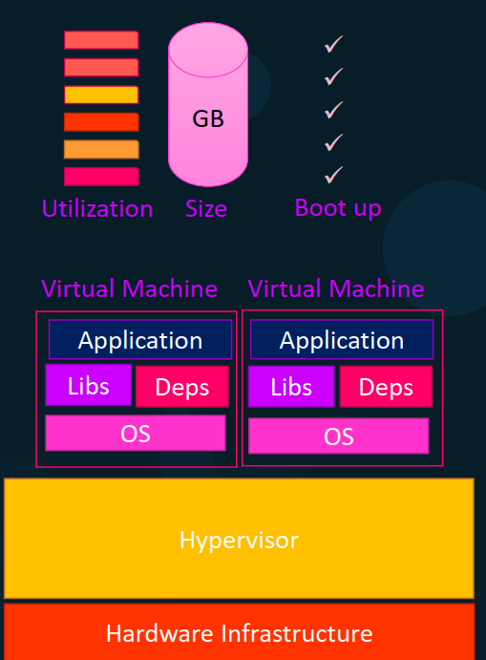
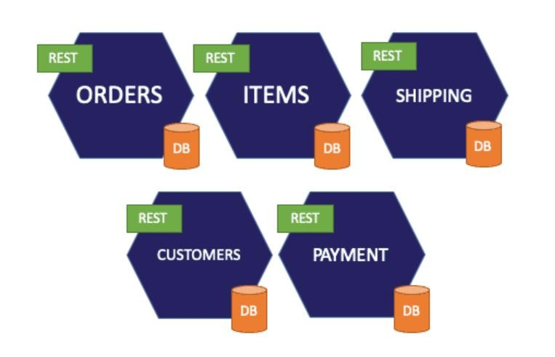
Microservices on VMs
Run each service with its own dependencies in separate VMs
Each VM has its own underlying OS and hosts a
Microservice
Strong isolation and resource control between other VMs and host
Each VM can have its own dependencies and libraries for the services. So different services across VMs can have different versions of same dependency
Matrix from hell problem is no more

Slide 9
Microservices based Applications
Pros Cons
Decoupled
Ensures continuous delivery and deployment of large, complex applications.
Better testing — since services are smaller and faster to test.
Better deployments — each service can be deployed independently.
No long-term commitment to technology – when developing a new service, you can start with a new technology stack.
Slow bootup times of VMs
Increased memory consumption
Large OS footprint
Initial Costs are very High and this type of architecture demands for proficiency in the skills of the developers.
Testing is difficult and time-consuming because there is an additional complexity involved because of the distributed system.
Deployment Complexity – there is added operational complexity of deploying and managing a system that contains various service types.

Slide 10



Docker Containers

Slide 11
Dev: It works fine in my system!
Tester: It doesn’t work in my system
Docker
Before Docker
A developer sends code to a tester but it doesn’t run on the tester’s system due to various dependency issues, however it works fine on the developer’s end.
After Docker
As the tester and developer now have the same system running on Docker container, they both are able to run the application in the Docker environment without having to face differences in dependencies issue as before.

Slide 12
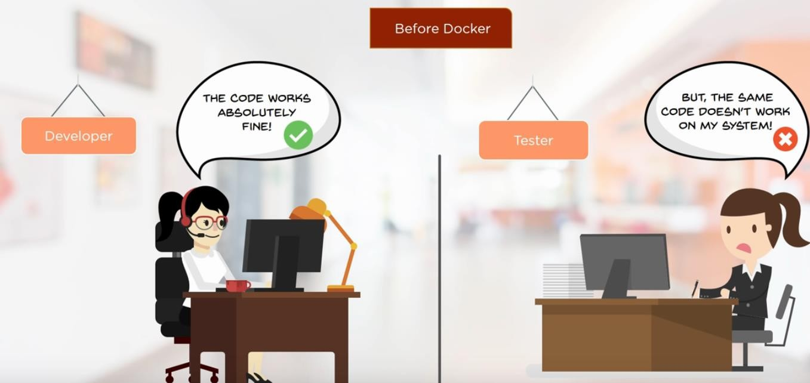

Slide 13
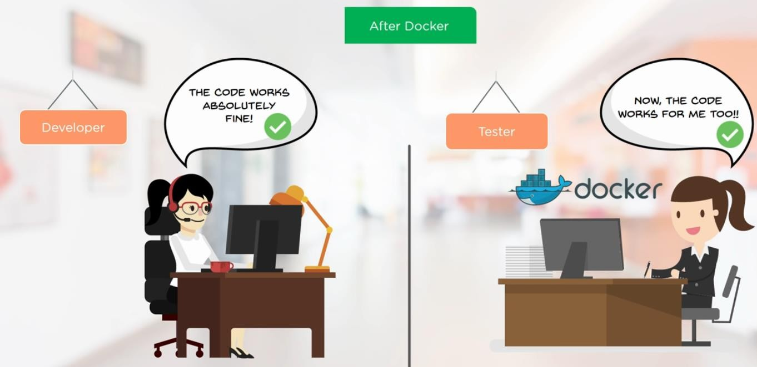

Slide 14

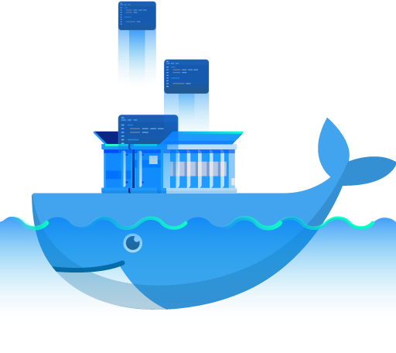
Docker
Docker is a software development tool and a virtualization technology that makes it easy to develop, deploy, and manage applications by using containers.
Container refers to a lightweight, stand-alone, executable package of a piece of software that contains all the libraries, configuration files, dependencies, and other necessary parts to operate the application.
Application
Ex: Ubuntu + Python + Dependencies
Dependencies
Ubuntu Base Image

Slide 15
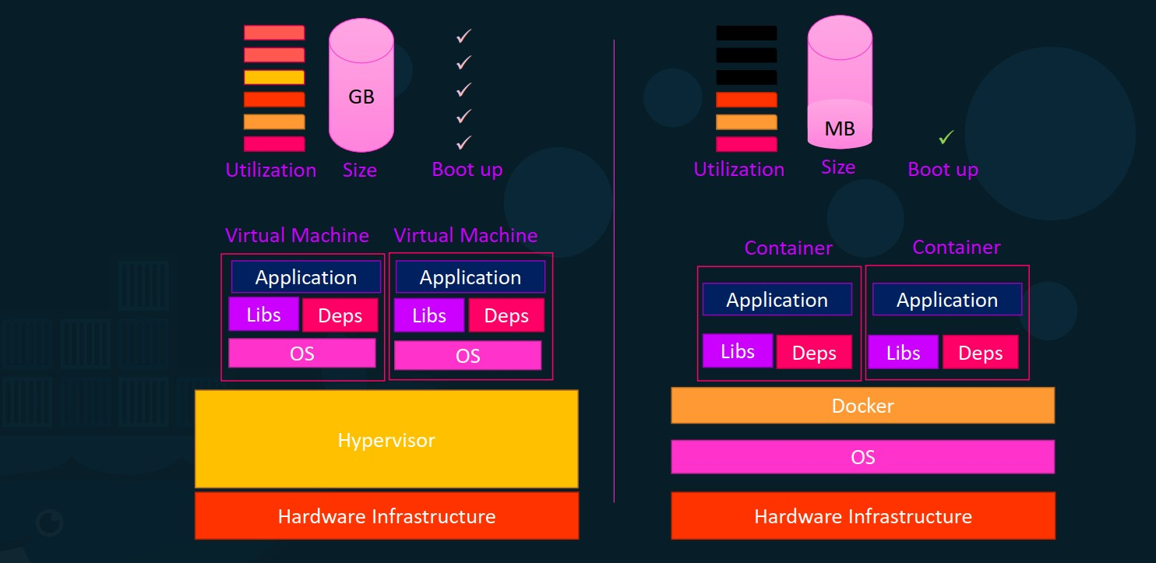
VMs vs Docker Containers

Slide 16
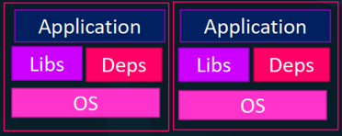
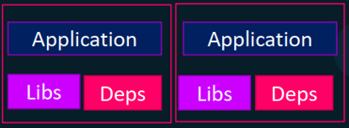
VMs vs Docker Containers
Virtual Machine | Docker Container
Hardware-level process isolation | OS level process isolation
Each VM has a separate OS | Each container can share OS
Boots in minutes | Boots in seconds
VMs are of few GBs | Containers are lightweight (KBs/MBs)
Ready-made VMs are difficult to find | Pre-built docker containers are easily available
VMs can move to new host easily | Containers are destroyed and re-created rather than moving
Creating VM takes a relatively longer time | Containers can be created in seconds
More resource usage | Less resource usage

Slide 17
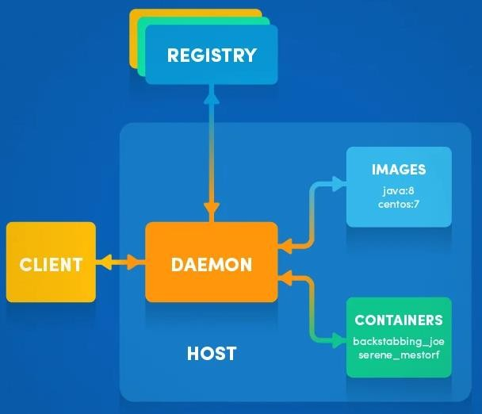
Docker Architecture
Docker uses a client-server architecture.
Docker client talks to the Docker daemon, which does the heavy lifting of building, running, and distributing your Docker containers.
Docker client and daemon can run on the same system, or you can connect a Docker client to a remote Docker daemon.
For a virtual communication between CLI client and Docker daemon, a REST API is used

Slide 18
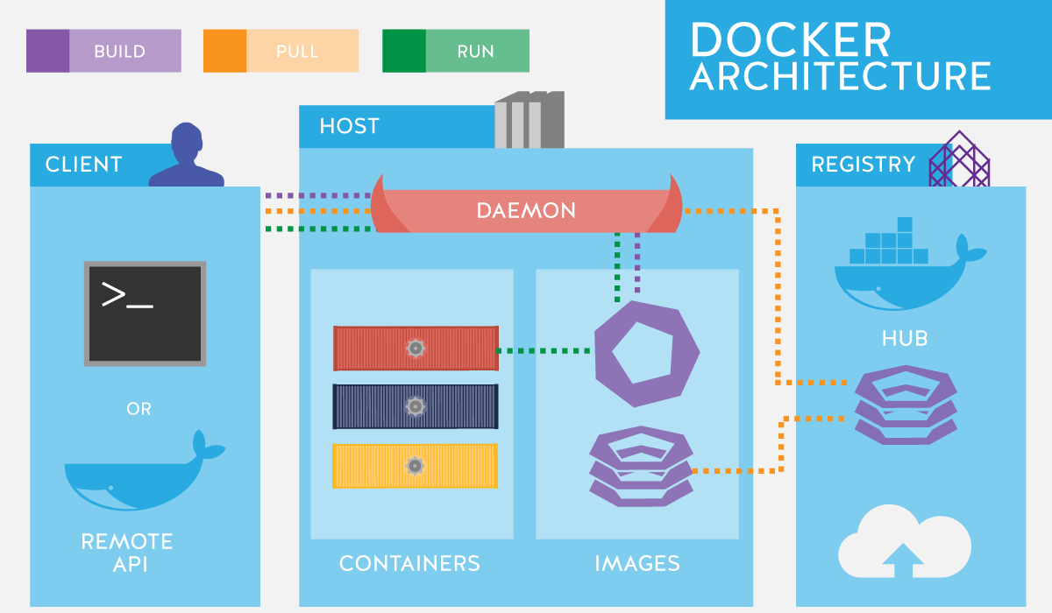
Docker Architecture

Slide 19

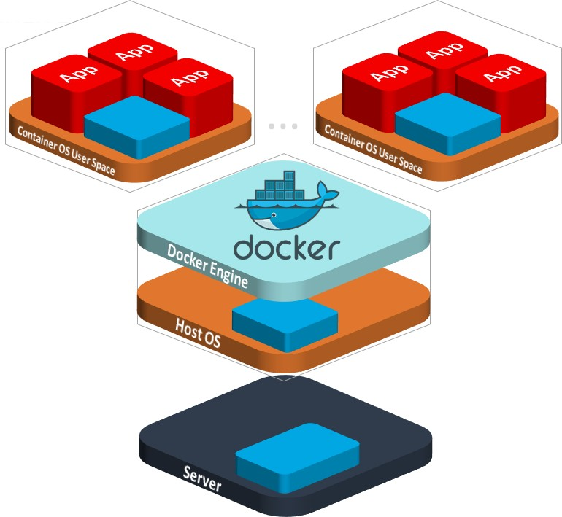
Docker Installation
Docker for Windows: Win10 Pro/Ent only Uses Hyper-V with tiny Linux VM for Linux Containers
Docker Toolbox: Win7/8/8.1 or Win10 Home Runs a tiny Linux VM in VirtualBox
Docker for MAC
Docker for Linux
Online Emulator: https://labs.play-with-docker.com/
https://docs.docker.com/get-docker/

Slide 20
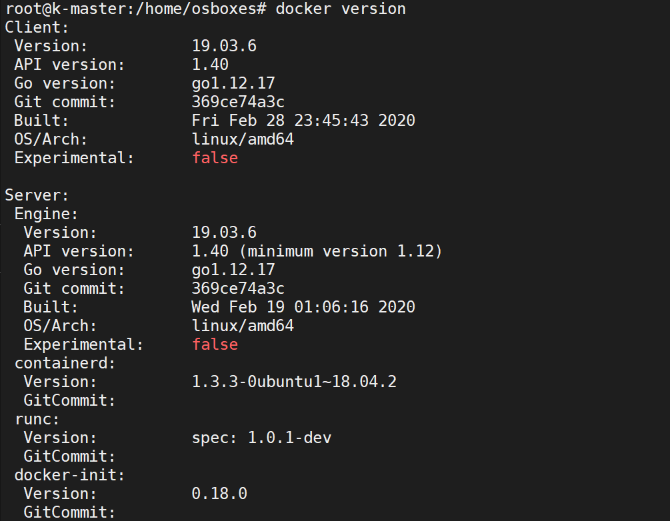
Docker basic commands
docker version

Slide 21
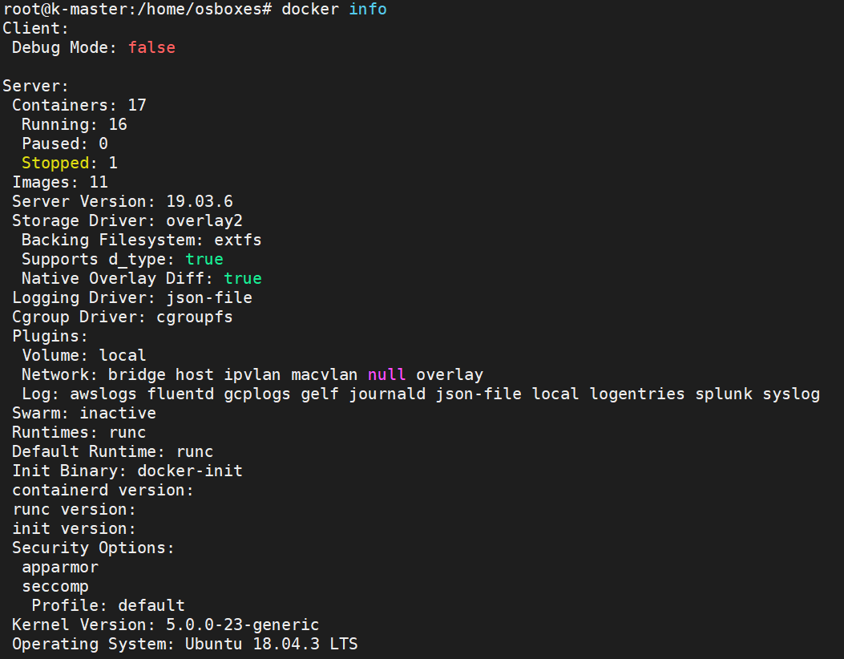
Docker basic commands
docker info

Slide 22


Docker Images & Containers
Docker Image: Docker image can be compared to a template that is used to create Docker containers. These are read-only templates that contains application binaries and dependencies. Docker images are stored in the Docker Registry.
Docker Container: Docker container is a running instance of a Docker image as they hold the entire package needed to run the application.
Application
Run
Dependencies
Docker Image
Ubuntu Base Image
Container

Slide 23
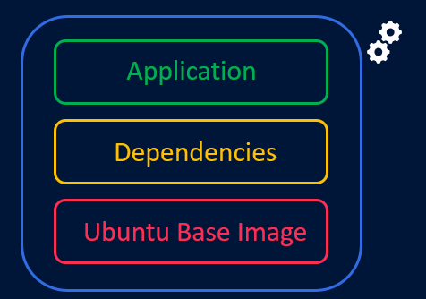

Docker Images & Containers
We can run any number of containers based out of an image and Docker makes sure that each container created has a unique name in the namespace.
Docker image is a read-only template. Changes made in containers won’t be
saved to the image by default
Container 01
Container 02
Docker Image
Container 03

Slide 24
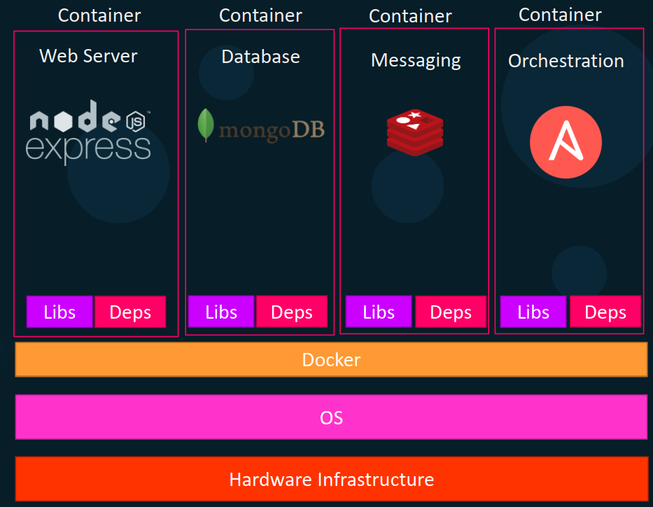
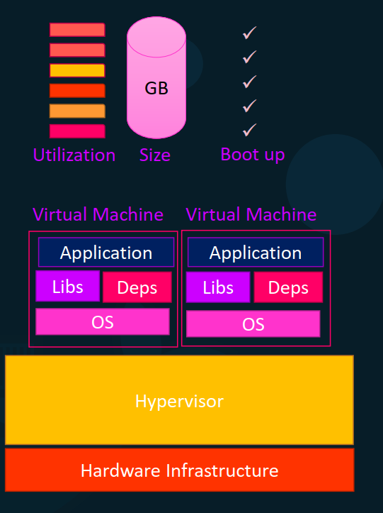
Docker Images & Containers
Containers run each service with its own dependencies in separate containers

Slide 25
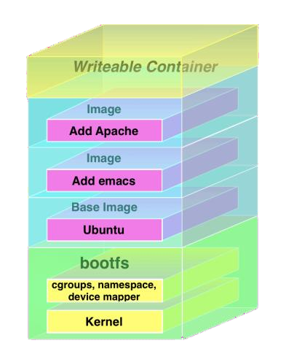
Union File System
A docker image is a read-only template for creating containers.
Changes made to the file system inside the running
container won’t be directly saved on to the image.
Instead , if a container needs to change a file from the read-only image that provides its filesystem, it copies the file up to its own private read-write layer before making the change
This is called copy-on-write (COW) mechanism.
These new or modified files and directories are 'committed' as a new layer.
docker history command shows all these layers.

Slide 26
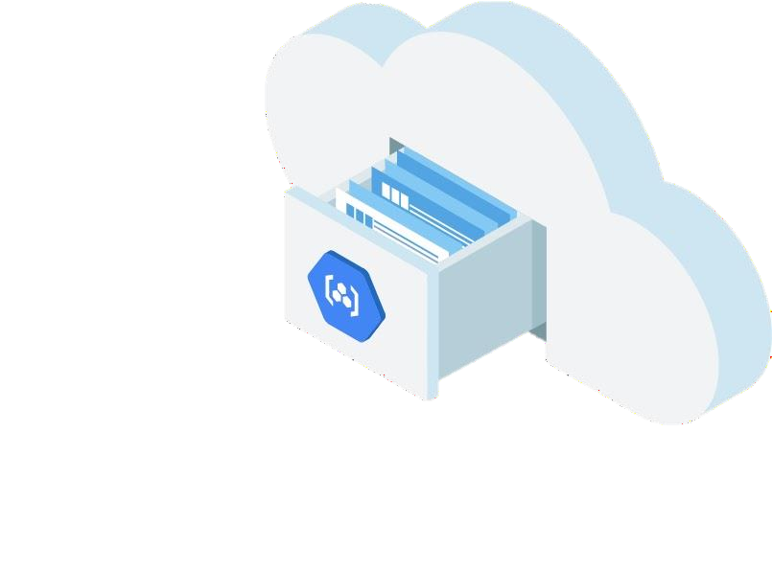
Docker Registry
Docker registry is a storage and distribution system for Docker images.
It is organized into Docker repositories , where a repository holds all the versions of a specific image.
By default, the Docker engine interacts with DockerHub , Docker's public registry instance.
However, it is possible to run on-premise private repositories Ex: Harbor
Some Cloud Provider repos
Amazon Elastic Container Registry
Google Container Registry
Azure Container Registry

Slide 27
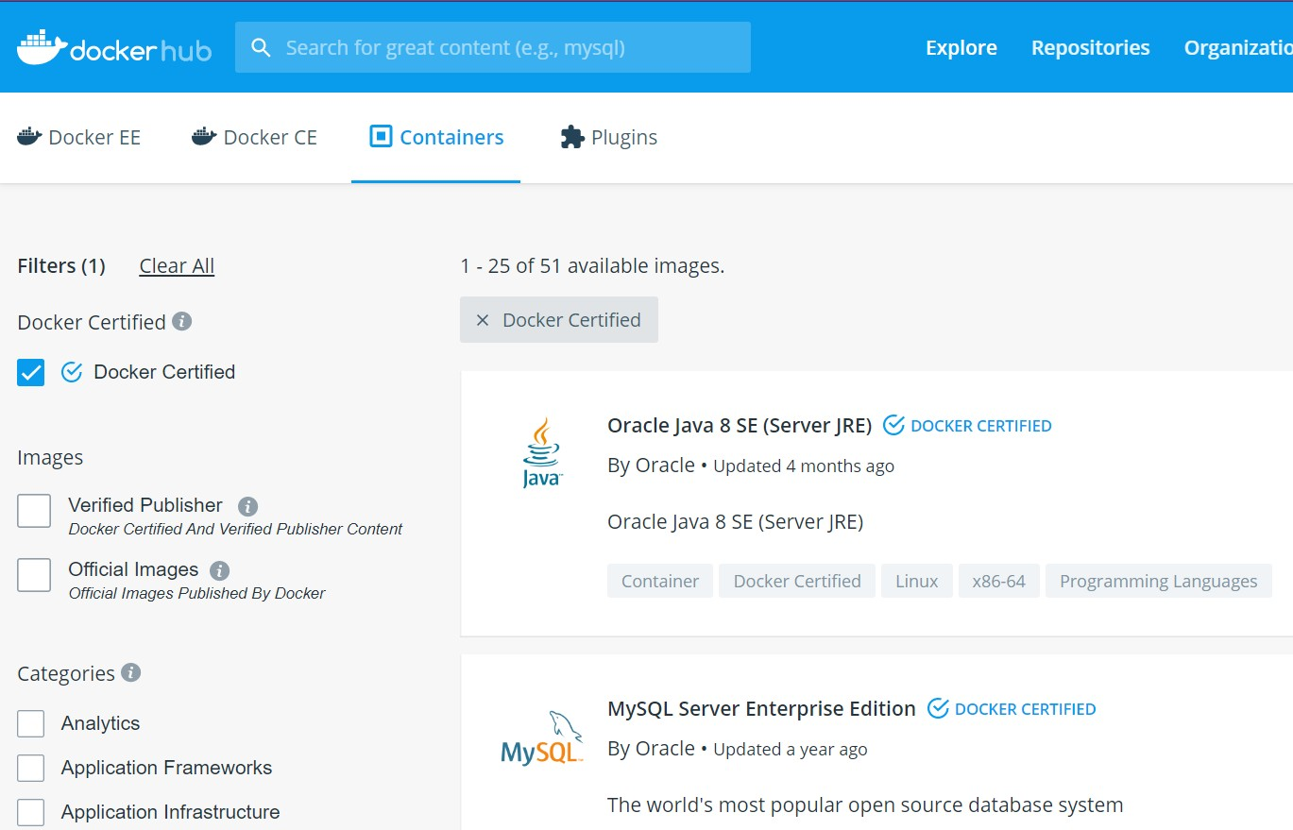
Docker Registry
https://hub.docker.com/

Slide 28
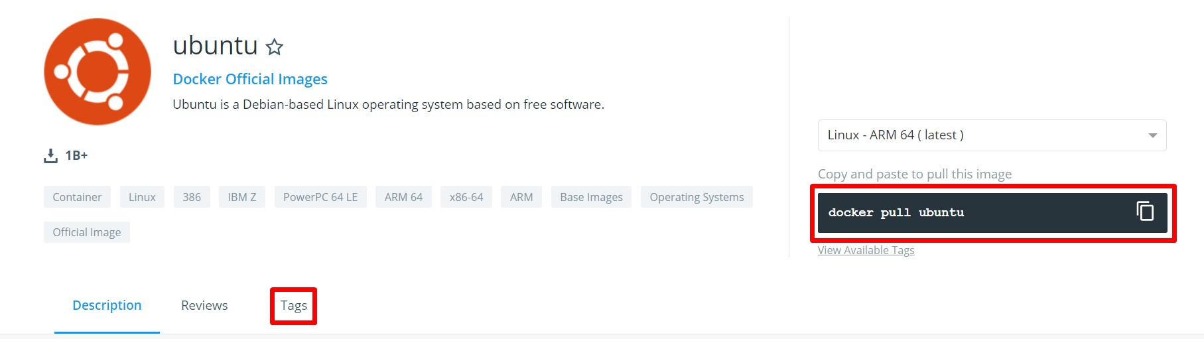
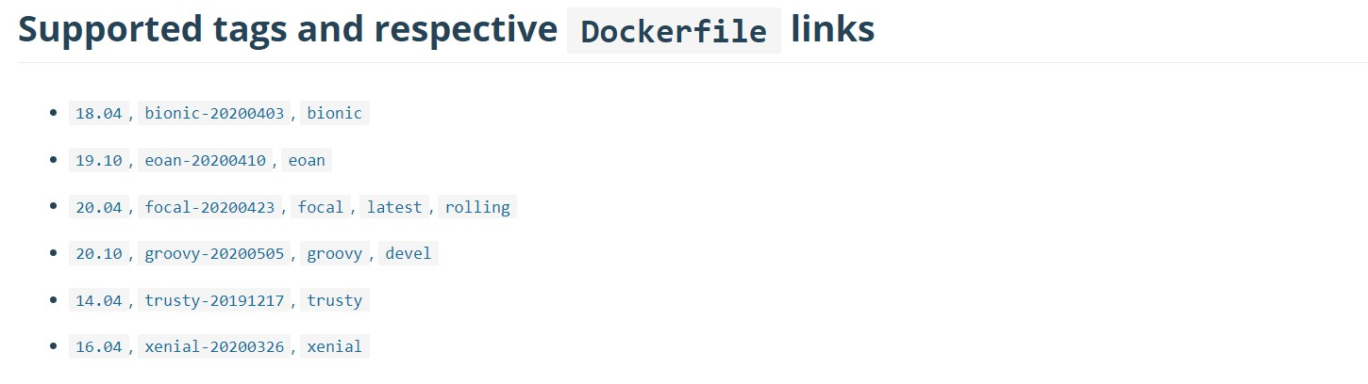
Docker Registry
Image name: username/image-name
docker pull ubuntu:19.10

Slide 29

Docker pull
By default, docker pull will pull an image from docker hub. If you need to pull from a private repo, use repo URL
docker pull myregistry.local:5000/testing/test-image
docker pull ubuntu
root@k-master:/home/osboxes# docker pull ubuntu
Using default tag: latest
latest: Pulling from library/ubuntu d51af753c3d3: Pull complete fc878cd0a91c: Pull complete 6154df8ff988: Pull complete fee5db0ff82f: Pull complete Digest:
sha256:747d2dbbaaee995098c9792d99bd333c6783ce56150d1b11e3 33bbceed5c54d7
Status: Downloaded newer image for ubuntu:latest

Slide 30
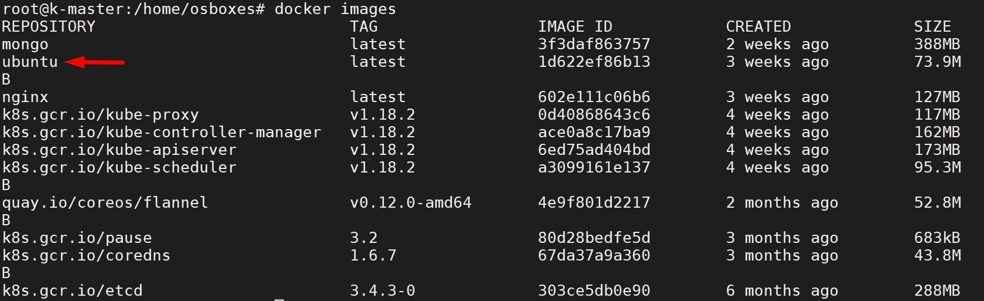
Docker pull
docker images

Slide 31
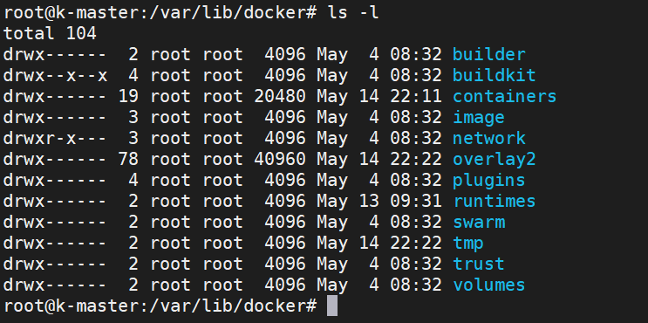
Docker home directory
/var/lib/docker
docker stores all the images, containers, volumes, networks information in it’s default home
directory

Slide 32
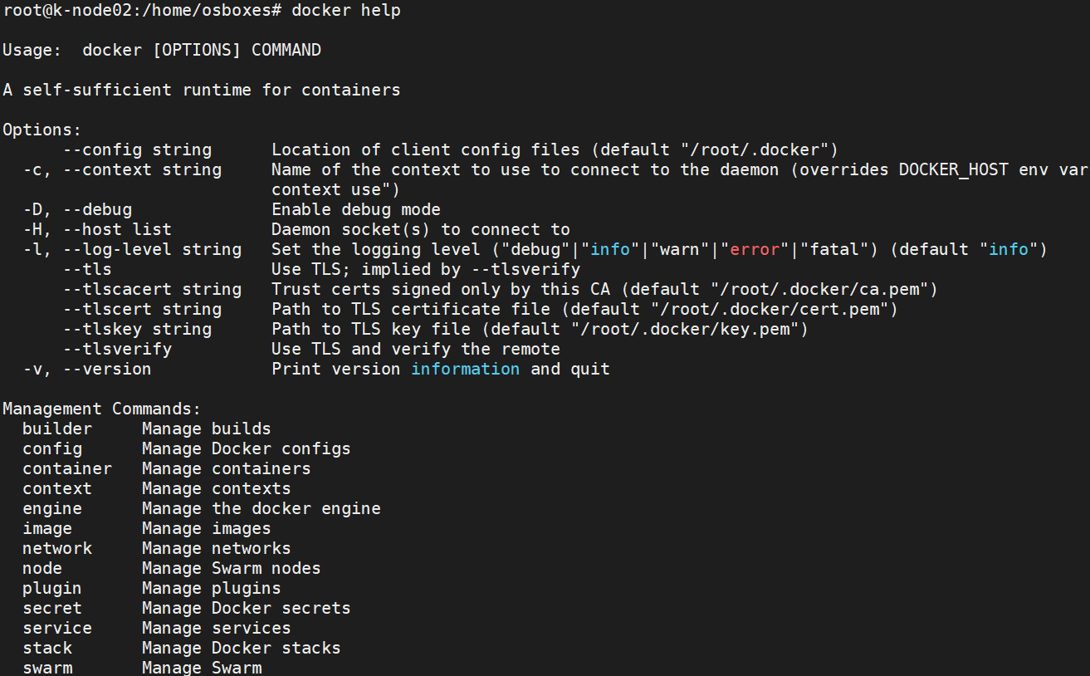
Docker basic commands
Format: docker <command> <sub-command>
docker image ls
docker help

Slide 33
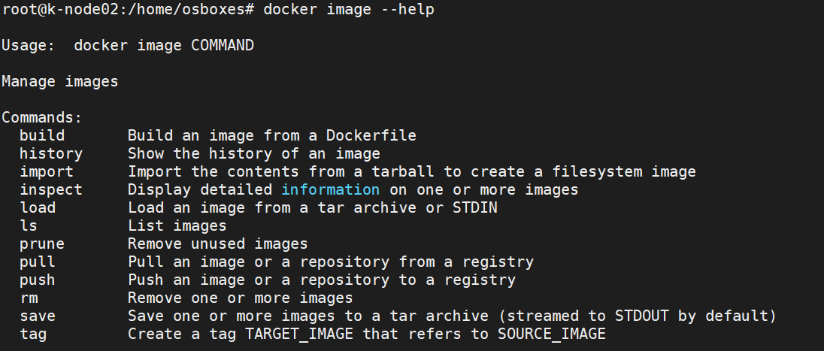
Docker basic commands
docker <command> <sub-command>
docker image ls
docker image --help

Slide 34

Docker Container basics
Running a container docker container run nginx
What happens in 'docker container run'
Docker looks for that image locally in image cache
If it doesn't find anything, it looks in remote image repository
Downloads the latest version (nginx:latest by default)
Creates new container based on that image and prepares to start
Container gets attached to a network and gets a virtual IP inside the private network, typically default bridge network
Opens up ports to serve the requests
7. Starts process mentioned in the CMD of image’s
Dockerfile
NGINX is open source software for web serving, reverse proxying, caching, load balancing, media streaming, and
more

Slide 35


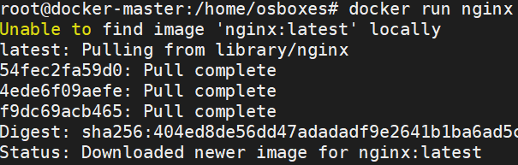
Docker Container basics
docker run nginx
Container
Docker host
When we run nginx, a container is created and it runs in the foreground and terminal is attached to its process
When we exit out of the terminal, the container will be killed
To avoid this we need to run the container in detached(background) mode using --detach
docker run --detach nginx

Slide 36
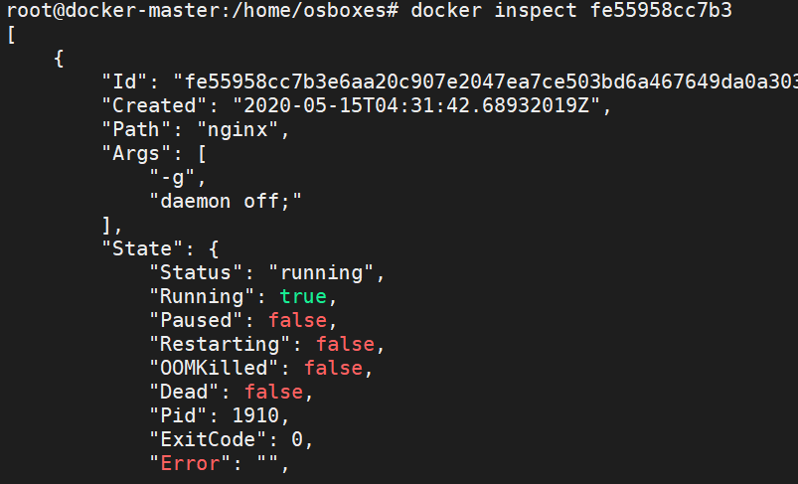
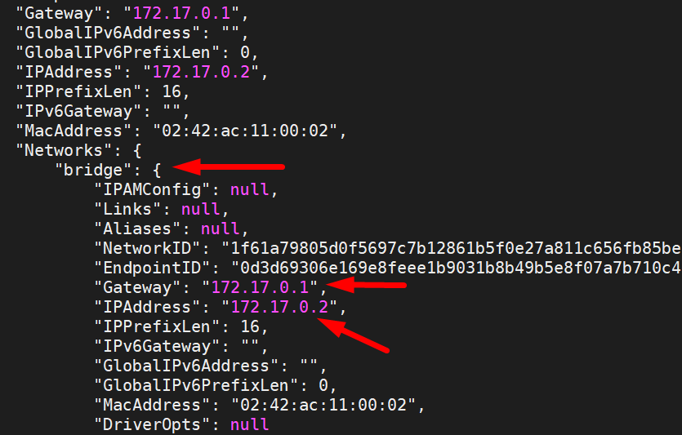
Docker Container basics
docker ps list all running containers
docker ps –a list all running and exited containers
docker container inspect <container-id> - gives the config and meta data used to start this container; returns JSON array

Slide 37
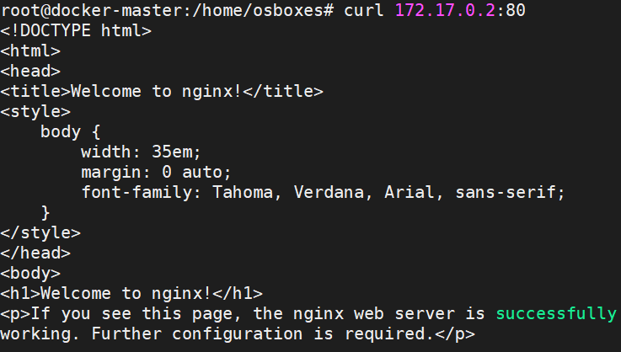
Docker Container basics
curl <ip-of-container>
80
Container
172.17.0.2
Docker host/VM
192.168.0.3
You can also find IP by running below command
root@docker-master:/home/osboxes# docker container inspect --format '{{.NetworkSettings.IPAddress}}’ fe559 172.17.0.2

Slide 38
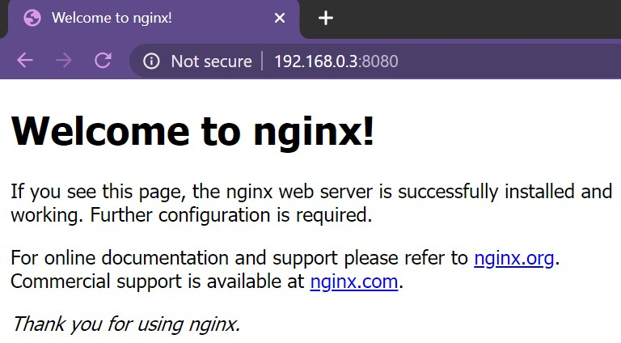
Docker Container basics: Port Mapping
curl <ip-of-container>
80
Container
172.17.0.2
Docker host/VM
192.168.0.3
8080
docker run –detach –p 8080:80 nginx

Slide 39
Docker Container
Naming a container: docker run --detach –p 8080:80 --name webhost nginx
Stop a container: docker container stop <unique container id>
Start a stopped container: docker start < unique container id>
Kill a container: docker container kill <unique container id>
Logs: docker container logs <container name>
docker container logs -f <container name>
Remove a container: docker container rm <container name>
Lists specific processes in a specific container
docker top <container>
Get CPU, Mem usage of the container docker container stats <container>
80
Container
172.17.0.2
Docker host/VM
192.168.0.3
8080

Slide 40

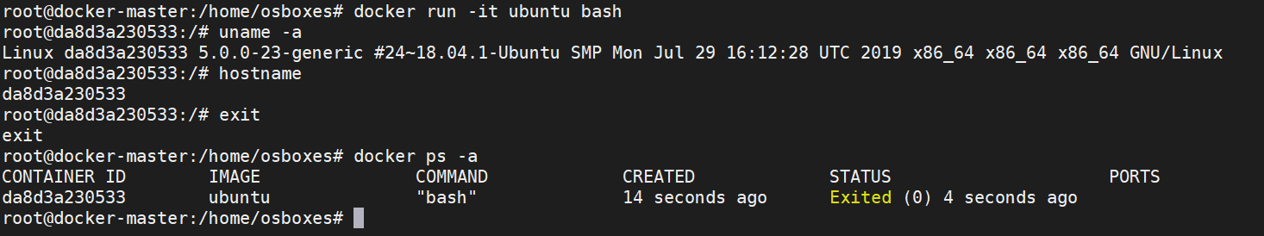
Docker Container: Getting shell access
Start new container interactively: Getting container’s shell access
docker container run -it <container-name> bash docker container run -it --name ubuntu bash
-i : interactive or STD_IN
-t : terminal or STD_OUT
Container
172.17.0.2
Docker host/VM 192.168.0.3

Slide 41
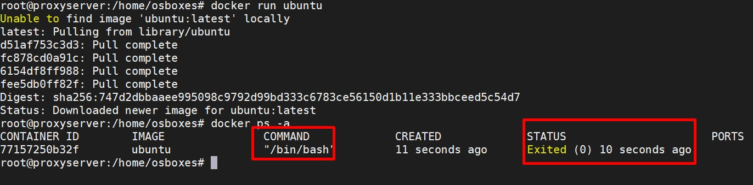
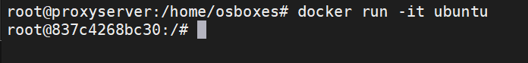
Docker Container: Getting shell access
Importance of -i -t flags
Any image that has shell as its starting process expects a terminal(-t)
and standard input(-i) to be attached when starting the container.
If the container doesn’t find the terminal, it simply exits.
Container
172.17.0.2
Docker host/VM 192.168.0.3

Slide 42
Docker Container: Getting shell access
Containers are not full fledged operating systems
They are meant to run a specific process/application
Containers run as long as process inside them is alive. When process completes, the container simply exits
Ubuntu runs bash as the starting process. When bash process is terminated, the container gets terminated.
Use image inspect to find default CMD of the image docker image inspect ubuntu
Container
172.17.0.2
Docker host/VM 192.168.0.3

Slide 43

Docker Container
Interacting with the running container
Use exec to interact with a running container docker run -it -d --name centos centos docker exec -it centos bash
Container
172.17.0.2
Commit changes in container to a image
By default changes made to container are lost once container is deleted, to preserve the changes, commit to an image
docker commit <container-id> <new-image-name>
Docker host/VM
192.168.0.3

Slide 44
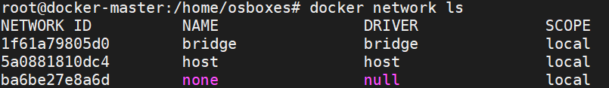
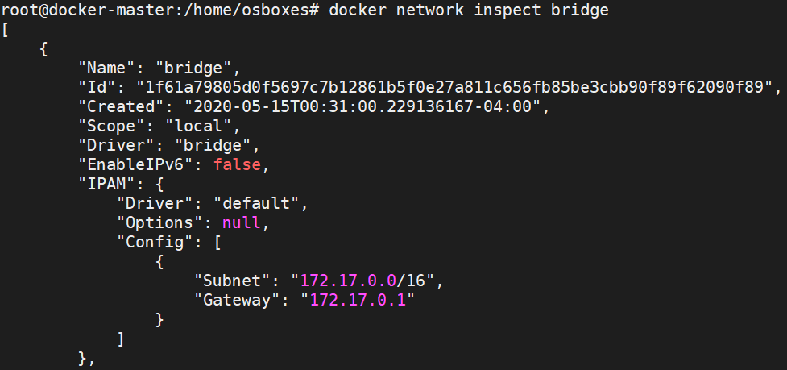
Docker Networking
Docker gives 3 default networks: bridge, none and host
When you start Docker, a default bridge network (also called bridge) is created automatically, and newly-started containers connect to it unless otherwise specified.
docker network ls
docker network inspect bridge

Slide 45
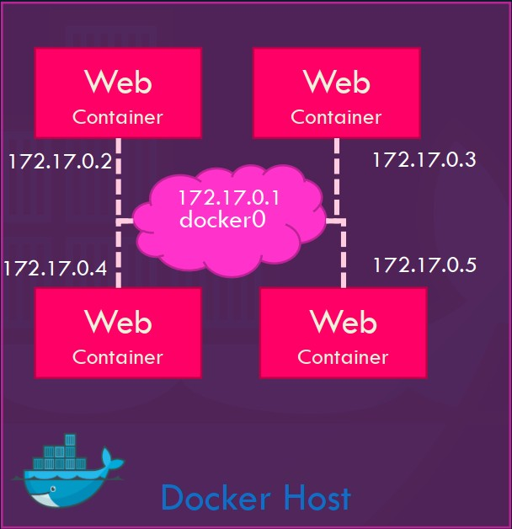
Docker Networking: Bridge
In Bridge network, all containers get private internal IPs and they are isolated from host.
Port forwarding forwards outside traffic to the containers.
Containers on the default bridge network can only access each other by IP addresses, unless you use the --link option, which is considered legacy.
You can also create user-defined custom bridge network
User-defined bridge networks are superior to the default bridge network.
On a user-defined bridge network, containers can resolve each other by name or alias(DNS)
Create a bridge network: docker network create --driver bridge my-net Attach a container to it: docker run -d --name web --net my-net nginx

Slide 46
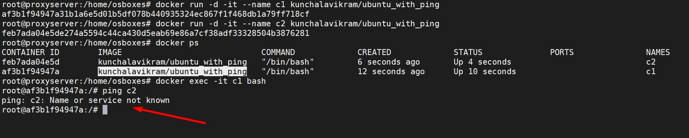
Docker Networking: Bridge
Understanding DNS resolution in bridge network
When containers are run in default bridge network they cannot find each other using their container names.
Simply put, DNS resolution through container names will not work under default bridge network
In the below example, 2 containers are created under the default bridge network
Note that ping to second container from the first container using the second container’s name didn’t resolve(DNS server is not
available under default bridge network)

Slide 47
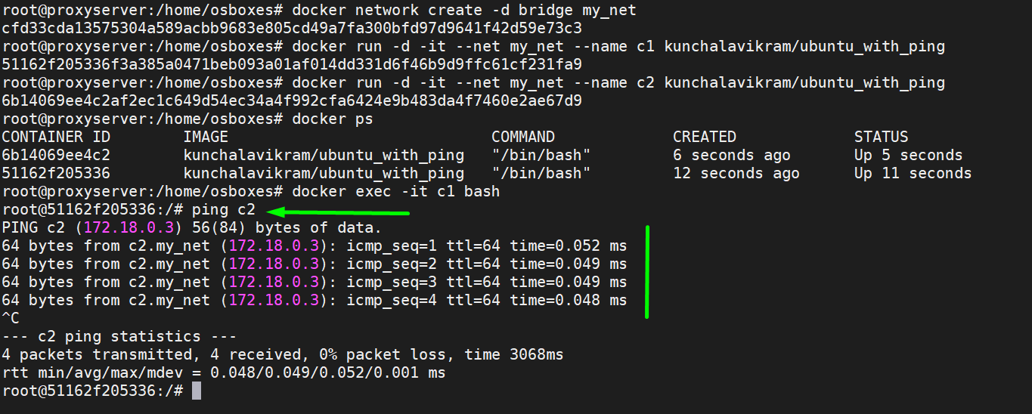
Docker Networking: Bridge
Understanding DNS resolution in bridge network
Now a new bridge network is created and containers are attached to that network.
In this case, containers find each other using their container names(DNS resolution through container names)

Slide 48

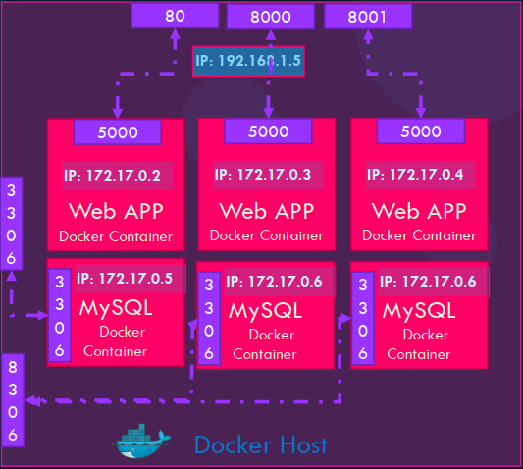
Docker Networking: Port Mapping
Port forwarding enables access to applications running inside containers from outside world
192.168.0.3:80
docker run –p 80:5000 nginx docker run –p 8000:5000 nginx docker run –p 8001:5000 nginx docker run –p 3306:3306 mysql docker run –p 8306:3306 mysql docker run -p 8306:3306 mysql
Port is already allocated
192.168.0.3

Slide 49
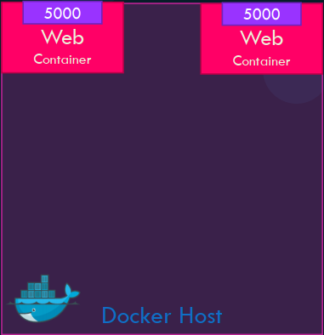
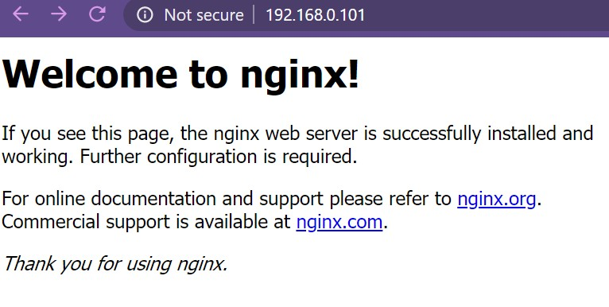
Docker Networking: Host
80
80
In host network, all containers directly get connected to
host.
Multiple containers cannot run on same hosts because of port conflicts on host side
docker run -d --name web -net host nginx
192.168.0.101

Slide 50
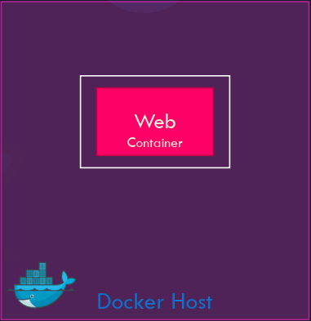
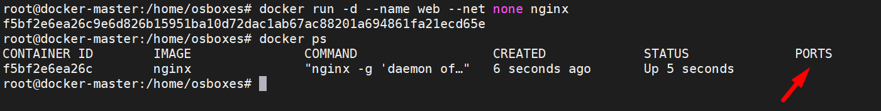

Docker Networking: None
This offers a container-specific network stack that lacks a
network interface.
Containers run in pure isolation
This container only has a local loopback interface (i.e., no external network interface)
docker run -d --name web --net none nginx

Slide 51

Docker Networking: Overlay
Bridge networks apply to containers running on the same Docker daemon host. For communication among containers running on different Docker daemon hosts, we should use an overlay network which spans across the entire cluster

Slide 52
Docker Volumes
Images are a series of read-only layers
A container is merely an instantiation of those read-only layers with a single read-write layer on top.
Any file changes that are made within a container are reflected as a copy of modified data from the read-only layer.
The version in the read-write layer hides the underlying file but does not remove it.
When deleting a container, the read-write layer containing the changes are destroyed and gone forever!
In order to persist these changes we use docker volumes Advantages:
To keep data around when a container is removed
To share data between the host filesystem and the Docker container

Slide 53
Docker Volumes
Two types of volume mounts: Named and Bind
Named Volume: Mounting a volume created using ‘docker volume create’ command and mounting it from default volume location /var/lib/docker/volumes docker volume create my-vol
docker run -d --name nginx -v myvol:/app nginx
docker run -d --name nginx --mount source=myvol2,target=/app nginx
/app
Container
/var/lib/docker/volumes/myvol
Docker host

Slide 54
Docker Volumes
Two types of volume mounts: Named and Bind
Bind Volume: External mounting(external hard disks etc.)
Bind mounts may be stored anywhere on the host system. They usually start with
‘/’
docker run –name web -v /root/html:/var/www/html/ nginx
/var/www/html
Container
/root/html
Docker host

Slide 55


Docker volumes commands
docker volume create <volume_name> docker volume ls
docker volume inspect <volume_name> docker volume rm <volume_name> docker volume prune
Named Volume
Bind Volume

Slide 56





Docker Volumes
Demo: Hosting a static website using nginx docker run -d --name web –p 80:80 nginx docker exec -it web bash
root@768faf801706:/# ls /usr/share/nginx/html 50x.html index.html
docker run -d --name web -p 80:80 -v $PWD:/usr/share/nginx/html nginx
/usr/share/nginx/html
Container
$PWD/index.html
Docker host

Slide 57

Building Images
Hosting a static website was easier as base image nginx has all dependencies to host.
What if we are required to host an application which requires lot of dependencies which base image do not provide? We build the image!!!
Let’s say a flask application has to be built
docker run –it --name my-app ubuntu bash root@beb164a51e6a:/# apt update root@beb164a51e6a:/# apt install python root@beb164a51e6a:/# pip install flask root@beb164a51e6a:/# exit
docker commit my-app my-flask-app
app.py
pip install flask
apt install python
apt update
container-name
image-name

Slide 58

Dockerfile
Dockerfile is essentially the build instructions to build your image
It is a text document that contains all the commands a user could call on the command line to assemble the image
Using docker build users can create an automated build that executes several command-line instructions in succession
Name of the file is Dockerfile without any extensions

Slide 59
Dockerfile contents
FROM defines the base image used to start the build process
MAINTAINER defines a full name and email address of the image creator
COPY copies one or more files from the Docker host into the Docker image
EXPOSE exposes a specific port to enable networking between the container and the outside world
RUN runs commands while image is being built from the dockerfile and saves result as a new layer
VOLUME is used to enable access from the container to a directory on the host machine
WORKDIR used to set default working directory for the container
CMD command that runs when the container starts
ENTRYPOINT command that runs when the container starts
http://tutorials.jenkov.com/docker/dockerfile.html

Slide 60


Dockerfile
flask_app
Dockerfile app.py
FROM python:alpine3.7 COPY . /app
WORKDIR /app RUN pip install flask EXPOSE 5000
CMD python ./app.py
(or)
Build the image:
docker build -t flaskapp .
(make sure you are in the directory of docker file and Dockerfile has no name extensions)
-t – Tag the image with a name
. – Dot indicates look for Dockerfile from PWD/Present Working Directory
FROM ubuntu
RUN apt-get update
RUN apt-get install -y python python-pip wget RUN pip install Flask
COPY app.py /home/app.py
WORKDIR /home
CMD python app.py
Source: https:///Docker_public/tree/ master/Examples/Dockerfile-flask

Slide 61



Dockerfile
docker images
FROM python:alpine3.7 COPY . /app
WORKDIR /app RUN pip install flask EXPOSE 5000
CMD python ./app.py
docker run -d --name flask -p 80:5000 flaskapp
Flask listens on port 5000 by default. You can also configure it to a different port

Slide 62
Dockerfile
Demo: Building a single landing page dynamic website using flask
flask_app
Dockerfile appv3.py static/image.jpg
templates/index.html
import socket
from flask import Flask,request, render_template
appv3.py
Dockerfile
FROM python:alpine3.7 COPY . /app
WORKDIR /app RUN pip install flask EXPOSE 5000
CMD python ./appv3.py
def getIP():
hostname = socket.gethostname()
s = socket.socket(socket.AF_INET, socket.SOCK_DGRAM) s.connect(("8.8.8.8", 80))
ip = s.getsockname()[0] print(ip)
s.close()
return str(hostname),str(ip)
index.html file should in templates directory and image should be in static directory
app = Flask( name ) @app.route("/")
def hello():
We will pass these
variables to index.html file
Source: https://github.com/kunchalavikram1 427/Docker_public/tree/master/Exa mples/Dockerfile-flask-example
hostname,ip = getIP()
return render_template('index.html',hostname=hostname,ip=ip)
if name == " main ":
app.run(host="0.0.0.0", port=int("5000"), debug=True)

Slide 63

Dockerfile
Demo: Building a single landing page dynamic website using flask
index.html
<!DOCTYPE html>
<html>
<title>Smart City</title>
<meta charset="UTF-8">
<meta name="viewport" content="width=device-width, initial-scale=1">
<link rel="stylesheet" href="https://www.w3schools.com/w3css/4/w3.css">
<link rel="stylesheet" href="https://fonts.googleapis.com/css?family=Raleway">
<style>
body,h1 {font-family: "Raleway", sans-serif} body, html {height: 100%}
.bgimg {
background-image: url('/static/smartcity.jpg'); min-height: 100%;
background-position: center; background-size: cover;
}
</style>
<body>
<div class="bgimg w3-display-container w3-animate-opacity w3-text-white">
<div class="w3-display-topleft w3-padding-large w3-xlarge">
Connected City
</div>
<div class="w3-display-middle">
<h1 class="w3-jumbo w3-animate-top" style="text-align:center"> Connected City </h1>
<hr class="w3-border-grey" style="margin:auto;width:40%">
<p class="w3-large w3-center"> Website processed by container: {{ hostname }} with IP: {{ ip }} </p>
</div>
<div class="w3-display-bottomleft w3-padding-large">
Powered by <a href="https://" target="_blank">Github</a>
</div>
</div>
</body>
</html>
Build Image and Push to docker hub docker build –t <username>/flask-app . docker push <username>/flask-app
<username> - Your docker hub account name
Run the container
docker run -d --name <user-name>/flask-app -p 80:5000 flaskapp
192.168.0.2

Slide 64

Docker Compose
Docker Compose is used to run multiple containers as a single service.
For example, an application requires both NGNIX and MySQL containers, you could create one file which would start both the containers as a service(docker compose) or start each one separately(docker run)
All services are to be defined in YAML format
compose file: docker-compose.yml
3306
80
Bring up the app: docker-compose up –d Bring down the app: docker-compose down
back-end
172.17.0.3
front-end
172.17.0.2
Docker host/VM
192.168.0.3
8080
https://takacsmark.com/docker-compose-tutorial-beginners-by-example-basics/

Slide 65

Docker Compose
Compose file syntax
version: '3' # if no version is specified then v1 is assumed.
services: # containers. same as docker run
service_name: # container name. this is also DNS name inside network image: # name of the image
command: # Optional, replace the default CMD specified by the image
environment: # same as -e in docker run ports: # same as –p in docker run
volumes: # same as -v in docker run service_name2:
3306
80
back-end
172.17.0.3
front-end
172.17.0.2
volumes: # Optional, same as docker volume create
Docker host/VM
192.168.0.3
8080
networks: # Optional, same as docker network create

Slide 66
Docker Compose versions
Version 1
Compose files that do not declare a version are considered “version 1”
Do not support named volumes, user-defined networks or build arguments
Every container is placed on the default bridge network and is reachable from every other container
at its IP address. You need to use links to enable discovery between containers
No DNS resolution using container names
Version 2
Links are deprecated. DNS resolution through container names
All services must be declared under the ‘services’ key
Named volumes can be declared under the volumes key, and networks can be declared under the networks key
New bridge network to connect all containers
Version 3
Support for docker swarm

Slide 67


Docker Compose
wordpress:
image: wordpress depends_on:
mysql ports:
- 8080:80
environment: WORDPRESS_DB_HOST: mysql WORDPRESS_DB_NAME: wordpress WORDPRESS_DB_USER: wordpress
WORDPRESS_DB_PASSWORD: wordpress
volumes:
./wordpress-data:/var/www/html networks:
my_net
mysql:
image: mariadb environment:
MYSQL_ROOT_PASSWORD: wordpress MYSQL_DATABASE: wordpress MYSQL_USER: wordpress MYSQL_PASSWORD: wordpress volumes:
mysql-data:/var/lib/mysql networks:
my_net
version: '3.3' services:
wordpress:
image: wordpress depends_on:
mysql ports:
- 8080:80
environment: WORDPRESS_DB_HOST: mysql WORDPRESS_DB_NAME: wordpress WORDPRESS_DB_USER: wordpress
WORDPRESS_DB_PASSWORD: wordpress volumes:
./wordpress-data:/var/www/html networks:
my_net mysql:
image: mariadb environment:
MYSQL_ROOT_PASSWORD: wordpress MYSQL_DATABASE: wordpress MYSQL_USER: wordpress MYSQL_PASSWORD: wordpress volumes:
mysql-data:/var/lib/mysql networks:
my_net volumes: mysql-data: networks: my_net:
volumes: mysql-data: networks: my_net:
3306
80
Docker host/VM
8080

Slide 68

Docker Compose
version: '3.3' services:
wordpress:
image: wordpress depends_on:
mysql ports:
- 8080:80
environment: WORDPRESS_DB_HOST: mysql WORDPRESS_DB_NAME: wordpress WORDPRESS_DB_USER: wordpress
WORDPRESS_DB_PASSWORD: wordpress volumes:
./wordpress-data:/var/www/html networks:
my_net mysql:
image: mariadb environment:
MYSQL_ROOT_PASSWORD: wordpress MYSQL_DATABASE: wordpress MYSQL_USER: wordpress MYSQL_PASSWORD: wordpress volumes:
mysql-data:/var/lib/mysql networks:
my_net volumes: mysql-data: networks: my_net:
Services file: docker-compose.yml
3306
80
Bring up: docker-compose up –d Bring down: docker-compose down Process state: docker-compose ps
Docker host/VM
8080

Slide 69


Docker Compose
33
8
0
06
Docker host/VM
808
0

Slide 70
Docker Compose
Image build
version: '3.3'
services:
wordpress:
image: wordpress depends_on:
mysql ports:
- 8080:80
environment: WORDPRESS_DB_HOST: mysql WORDPRESS_DB_NAME: wordpress WORDPRESS_DB_USER: wordpress
WORDPRESS_DB_PASSWORD: wordpress volumes:
./wordpress-data:/var/www/html networks:
my_net
mysql:
image: mariadb environment:
MYSQL_ROOT_PASSWORD: wordpress MYSQL_DATABASE: wordpress MYSQL_USER: wordpress MYSQL_PASSWORD: wordpress volumes:
mysql-data:/var/lib/mysql
networks:
my_net volumes: mysql-data: networks: my_net:
If the image has to be built before deployment, include dockerfile in compose file
version: "3" services:
wordpress: build:
context: .
dockerfile: Dockerfile-wordpress image: wordpress container_name: wordpress
webapp
docker-compose.yml
Dockerfile-wordpress
3306
80
To build only images: docker-compose build
build + deploy: docker-compose up -d
Docker host/VM
8080

Slide 71
Docker Compose
version: '3.3' services:
wordpress:
image: wordpress depends_on:
mysql ports:
- 8080:80
environment: WORDPRESS_DB_HOST: mysql WORDPRESS_DB_NAME: wordpress WORDPRESS_DB_USER: wordpress
WORDPRESS_DB_PASSWORD: wordpress volumes:
./wordpress-data:/var/www/html networks:
my_net mysql:
image: mariadb environment:
MYSQL_ROOT_PASSWORD: wordpress MYSQL_DATABASE: wordpress MYSQL_USER: wordpress MYSQL_PASSWORD: wordpress volumes:
mysql-data:/var/lib/mysql networks:
my_net volumes: mysql-data: networks: my_net:
Deployment through imperative commands
docker network create –driver bridge my_net docker volume create mysql-data
docker run --name wordpress –p 8080:80 –v ./wordpress-data:/var/www/html \
–net my_net –e WORDPRESS_DB_HOST = mysql \
-e WORDPRESS_DB_NAME: wordpress \
-e WORDPRESS_DB_USER: wordpress \
-e WORDPRESS_DB_PASSWORD: wordpress \
wordpress
docker run --name wordpress –p 3306 –v mysql-data:/var/lib/mysql –net my_net
-e MYSQL_ROOT_PASSWORD: wordpress \
-e MYSQL_DATABASE: wordpress \
-e MYSQL_USER: wordpress \
-e MYSQL_PASSWORD: wordpress \ mariadb
3306
80
Docker host/VM
8080

Slide 72



NEXT
Docker Swarm

Slide 73

Docker
Swarm

Slide 74
Container Orchestration
Containers are ephemeral by nature.
They stop when process inside them finishes, or ends because of an error.
Also a single container per service may not be sufficient enough to handle the growing traffic to the application.
In all the above scenarios we need a tool that can bring up the stopped containers or spin up new one’s to handle the growing traffic and to ensure Load balancing & High availability of the application all the time.
This is where container orchestration comes into play!!!
What is container orchestration?
Container orchestration is all about managing the lifecycles of containers, especially in large, dynamic
environments.
Provisioning and deployment of containers
Scaling up or removing containers to spread application load evenly across host infrastructure
Movement of containers from one host to another if there is a shortage of resources in a host, or if a
host dies
Load balancing of service discovery between containers

Slide 75

Docker Swarm
Swarm is Docker’s built in container orchestrator solution, its main purpose is to manage
containers in a cluster, i.e. a set of connected machines that work together.
When a new machine joins the cluster, it becomes a node in that swarm.
Using Docker Swarm we can achieve high availability, load balancing and Decentralized access of our applications.
Swarm comes built into the Docker Engine, you don’t need to install anything to get started.
What can one do by using Docker Swarm?
Deploying new containers to replace failed ones
Scale the number of containers for load balancing
Rolling out application updates among the containers in rolling update fashion
Rollback of applications to older versions
Bring down a node for maintenance without any application downtime

Slide 76

Docker Swarm Architecture
Docker client
Manager: manages the cluster
Worker: runs tasks assigned by scheduler
Scheduler: schedules containers onto nodes depending upon rules and filters
Discovery service: helps Swarm Manager discover new nodes and fetch the available nodes
Store: stores state of cluster; like cluster and swarm services info. Essentially a key-value db
192.168.0.3
Swarm Manager
Store
Discovery Service
Scheduler
APIs over HTTP
APIs over HTTP
Docker Daemon
Docker Daemon
Swarm worker
192.168.0.4
Swarm worker
192.168.0.5
-- container

Slide 77

Docker Swarm: Overlay driver
Bridge networks apply to containers running on the same Docker daemon host. For communication among containers running on different Docker daemon hosts like in swarm, we should use an overlay network
If you create swarm services and do not specify a network, they are connected to default ingress network, which is also of overlay type
Overlay network spans across the entire swarm cluster, allowing communication between containers across multiple nodes
docker network ls
https://docs.docker.com/engine/swarm/ingress/

Slide 78
Docker Swarm: Start a cluster
docker swarm init --advertise-addr MANAGER_IP
root@docker-master # docker swarm init --advertise-addr 192.168.0.100
Swarm initialized: current node (pet61mspmyfvk6lz0klisd9e9) is now a manager.
master node
To add a worker to this swarm, run the following command:
docker swarm join --token SWMTKN-1-3kabuqlekspyqdk02vj0strami9mcysj8lw4klp5cwmh3wm4ej- 9rlom6m90chce1tgi0ke58t4l 192.168.0.100:2377
To add a manager to this swarm, run 'docker swarm join-token manager' and follow the instructions.
root@docker-slave01 # docker swarm join --token SWMTKN-1- 3kabuqlekspyqdk02vj0strami9mcysj8lw4klp5cwmh3wm4ej-9rlom6m90chce1tgi0ke58t4l 192.168.0.100:2377 This node joined a swarm as a worker.
worker node
root@docker-slave01:/home/osboxes#

Slide 79


Docker Swarm
docker node ls
80
80
80
front-end
front-end
front-end
overlay driver
Docker master
Docker worker 1
Docker worker 2
8080
8080
8080
192.168.0.100 192.168.0.101
192.168.0.102
root@docker-master # docker network ls | grep overlay qh17ylskxm31 ingress overlay swarm

Slide 80


Docker Service
To deploy an application image when Docker Engine is in swarm mode, you create a service.
A service is the image for a microservice like an HTTP server, a database, or any other type of executable program that you wish to run in a distributed environment.
A service needs container image to use, the port where the swarm makes the service available outside the swarm, an overlay network for the service to connect to other services in the swarm and the number of replicas of the image to run in the swarm.
Create a service
docker service create --replicas 5 -p 80:80 --name web nginx

Slide 81


Docker Service
docker service ls
80
80
80
80
80
overlay driver
Docker master
Docker worker 1
Docker worker 2
8080
8080
8080
192.168.0.100
192.168.0.101
192.168.0.102

Slide 82

Docker Swarm Visualizer
Deploy a visualizer
docker service create \
--name=viz \
--publish=8080:8080/tcp \
--constraint=node.role==manager \
--mount=type=bind,src=/var/run/docker.sock,dst=/var/run/docker.sock \
dockersamples/visualizer
Dashboard available at http://<node-ip>:8080
*node-ip: any IP of node participating in cluster
*although the pod is bound to master, it can be reached from all nodes because of ingress routing mesh
https://github.com/dockersamples/docker-swarm-visualizer

Slide 83


Docker Service
Name of the
service
docker service ps web
Name of the node
docker node ps docker-slave01

Slide 84

Docker Service
docker service ps web
192.168.0.100
192.168.0.101
192.168.0.104
Master Slave -01
docker service create --replicas 5 -p 80:80 --name web nginx
Slave -02

Slide 85
Docker Service
Scale a service
docker service scale <service_name>=8 docker service scale web=10
Update a service
docker service update --image <image_name>:<version> <service_name> docker service update --image nginx:1.18 web
Rolling update
docker service update –image <new_image> --update-parallelism 2 --update-delay 10s
<service_name>
docker service update --image nginx:1.18 --update-parallelism 2 --update-delay 10s web

Slide 86

Docker Service
Let’s say, a node is down because of an issue
In this case the affected containers in that node are recreated in available nodes in the cluster
docker service ls
docker service ps web

Slide 87
Docker Service
Let’s say, a node has to be brought down for maintenance
In this case we drain a node of its workloads onto other nodes for graceful termination
Drain a node: docker node update --availability drain <node-name> Undrain a node: docker node update --availability active <node-name>
Let’s say, the node is up and running after maintenance
By default, swarm doesn’t re-deploy the containers the node was previously running. We
need to force the cluster to share the load among the available nodes
Force workload balance: docker service update --force <service_name>
Rollback an update: docker service update --rollback <service_name> Remove a service: docker service rm <service_name>

Slide 88

Docker Swarm: Overlay driver
Creating overlay network
docker network create --driver overlay my_overlay
docker service create --replicas 5 -p 80:80 --network my_overlay --name web nginx Inspecting the service:
docker service inspect web
https://docs.docker.com/engine/swarm/ingress/

Slide 89
Docker Service
Demo: Swarm service
import socket
from flask import Flask
def getIP():
hostname = socket.gethostname()
s = socket.socket(socket.AF_INET, socket.SOCK_DGRAM) s.connect(("8.8.8.8", 80))
ip = s.getsockname()[0] print(ip)
s.close()
return hostname,ip
app = Flask( name )
@app.route("/")
def hello():
hostname,ip = getIP()
out = "Hello from hostname: " + hostname + " with host ip: " + ip return out
if name == " main ":
app.run(host="0.0.0.0", port=int("5000"), debug=True)
app.py
Dockerfile
FROM python:alpine3.7 COPY . /app
WORKDIR /app RUN pip install flask EXPOSE 5000
CMD python ./app.py
docker build –t <username>/flask-app . docker push <username>/flask-app
In order to use a custom image in swarm cluster, make sure to push this image to docker hub or private repo so that the swarm nodes will pull the image, or, make sure this image is available locally on all nodes by manually building the image from dockerfile. Swarm will not schedule containers
on to those nodes which fail to pull the image or do not have this image locally!

Slide 90


Docker Service
Demo: Swarm service
docker service create --replicas 5 -p 80:5000 --name web kunchalavikram/sampleflask:v2
visit
http://<node-ip>:80 and refresh the page to see the load balancing effect

Slide 91

Docker Service
Demo: Swarm service
Find similar swarm load-balancing demo at below link
https://levelup.gitconnected.com/load-balance-and-scale-node-js-containers-with-nginx-and-docker-swarm-9fc97c3cff81

Slide 92



Docker Networking
Ingress Network
192.168.0.24:80
Is it possible to run 2 containers with same host port published in non swarm mode?
docker run –d –p 80:5000 --name web1 flask docker run –d –p 80:5000 --name web2 flask
No!!! It results in port conflict. Docker daemon doesn’t allow
same host port for multiple containers in non swarm mode
Then how does docker allow running multiple instances of same application(with same host port mapping) in a node inside a swarm cluster?
docker service create --replicas 5 -p 80:5000 --name web flask
80
5000
5000
Flask
Webapp
Flask Webapp
172.17.0.4
172.17.0.5
Docker host
192.168.0.24
Ingress Routing Mesh

Slide 93




Docker Networking
Ingress Network
192.168.0.24:80
Ingress network has a built in load balancer that redirects traffic from published port on host to the mapped container ports
This allows multiple containers inside a docker host to use same host port without port collisions
No external setup is needed, the load balancer works out of the box with the ingress network
80
Load Balancer
Ingress Network
5000
5000
Flask Webapp
Flask Webapp
docker service create --replicas 5 -p 80:5000 --name web flask
172.17.0.4
172.17.0.5
Docker host
192.168.0.24

Slide 94








Docker Networking
Ingress Routing Mesh
docker service create --replicas 2 -p 80:5000 --name web flask
192.168.0.24:80
192.168.0.25:80
192.168.0.26:80
80
80
80
Load Balancer
Routing Mesh
Load Balancer
Routing Mesh
Load Balancer
Ingress Network
5000
5000
Flask Webapp
Flask Webapp
172.17.0.4
172.17.1.2
Docker Master
Docker Worker
Docker Worker
192.168.0.24
192.168.0.25
192.168.0.26

Slide 95

Docker Networking
Ingress Routing Mesh
The swarm internal networking mesh allows every node in the cluster to accept connections to any service port published in the swarm by routing all incoming requests to available nodes hosting a service with the published port.
docker service create --replicas 2 -p 80:5000 --name web flask

Slide 96


Docker Service
Ingress Routing Mesh
All nodes participate in an ingress routing mesh. The routing mesh enables each node in the swarm to accept connections on published ports for any service running in the swarm, even if there’s no task running on the node.
The routing mesh routes all incoming requests to published ports on available nodes to an active container.
In this scenario, we have 3 nodes and 4 replicas of web containers. The web containers are scheduled onto only Host 1 and Host 2. But still we can reach the web services from Host 3 because of swarm routing mesh
https://docs.docker.com/network/network-tutorial-overlay/ https://docs.docker.com/engine/swarm/ingress/

Slide 97

Docker Service
Load Balancer (ingress routing mesh)
The ingress network is a special overlay network that facilitates load balancing among a service's nodes. When any swarm node receives a request on a published port, it hands that request off to a
module called IPVS. IPVS keeps track of all the IP addresses participating in that service, selects one of them, and routes the request to it, over the ingress network.

Slide 98

Docker Swarm
Persistent Storage
Persistent storage is storing the data of the container beyond its lifecycle.
For single host containers, Bind or Named mounts works fine, but in order to share storage volumes across multiple Docker hosts, such as a Swarm cluster, we need distributed FS or Network FS.
Use of Distributed/Network FS
Because programs running on your cluster aren’t guaranteed to run on a specific node, data can’t be saved to any arbitrary place in the file system.
If a program tries to save data to a file for later, but is then relocated onto a new node, the file will no longer be where the program expects it to be.
Distributed/Network FS allows applications to have a common storage volume to store and
retrieve the data beyond its lifecycle.
https://theworkaround.com/2019/05/15/docker-swarm-persistent-storage.html

Slide 99



Docker Swarm
Persistent Storage in single node
Named Mount
Bind Mount
https://thenewstack.io/methods-dealing-container-storage/

Slide 100




Docker Swarm
Persistent Storage across cluster
Requires distributed/network file storage
NFS
GlusterFS
Ceph
Convoy
RexRay
PortWorx
StorageOS
GlusterFS
https://theworkaround.com/2019/05/15/docker-swarm-persistent-storage.html

Slide 101


Docker Stacks
Docker stack is used to deploy a complete application stack to the swarm.
Production grade docker-compose
Docker-compose is better suited for development scenarios and is a single host deployment solution
Uses the same syntax as docker-compose file, but with a new section ‘deploy’ added
to manifest file
Docker stack ignores “build” instructions. You can’t build new images using the stack
commands. It needs pre-built images to exist
3306
80
3306
80
3306
80
back-end front-end back-end front-end
back-end
front-end
overlay driver
Docker master
192.168.0.100
Docker worker 1 Docker worker 2
192.168.0.101
80
80
80
192.168.0.102

Slide 102

Docker Stack
wordpress:
image: wordpress depends_on:
mysql ports:
- 80:80
deploy:
replicas: 2 placement:
constraints:
- node.role == manager environment: WORDPRESS_DB_HOST: mysql WORDPRESS_DB_NAME: wordpress WORDPRESS_DB_USER: wordpress
WORDPRESS_DB_PASSWORD: wordpress volumes:
wordpress-data:/var/www/html networks:
my_net
mysql:
image: mariadb deploy:
replicas: 1 placement:
constraints:
- node.role == worker environment:
MYSQL_ROOT_PASSWORD: wordpress MYSQL_DATABASE: wordpress MYSQL_USER: wordpress MYSQL_PASSWORD: wordpress volumes:
mysql-data:/var/lib/mysql networks:
my_net
version: '3.3' services:
wordpress:
image: wordpress depends_on:
mysql ports:
- 80:80
deploy:
replicas: 2 placement:
constraints:
node.role == manager environment: WORDPRESS_DB_HOST: mysql WORDPRESS_DB_NAME: wordpress WORDPRESS_DB_USER: wordpress
WORDPRESS_DB_PASSWORD: wordpress
volumes:
wordpress-data:/var/www/html networks:
my_net mysql:
image: mariadb deploy:
replicas: 1 placement:
constraints:
node.role == worker environment:
MYSQL_ROOT_PASSWORD: wordpress MYSQL_DATABASE: wordpress MYSQL_USER: wordpress MYSQL_PASSWORD: wordpress volumes:
mysql-data:/var/lib/mysql networks:
my_net networks: my_net: volumes: mysql-data:
Constraints allow containers to be bound to a specific node. When these containers are down because of an issue, swarm re-deploys another one in the same node thus ensuring data persistency all the time
volumes:
mysql-data: wordpress-data: networks: my_net:
https://docs.docker.com/engine/swarm/services/#placement- constraints
https://thenewstack.io/methods-dealing-container-storage/
wordpress-data:

Slide 103

Docker Stacks
version: '3.3' services:
wordpress:
image: wordpress depends_on:
mysql ports:
- 80:80
deploy:
replicas: 2 placement:
constraints:
node.role == manager environment: WORDPRESS_DB_HOST: mysql WORDPRESS_DB_NAME: wordpress WORDPRESS_DB_USER: wordpress
WORDPRESS_DB_PASSWORD: wordpress
volumes:
wordpress-data:/var/www/html networks:
my_net mysql:
image: mariadb deploy:
replicas: 1 placement:
constraints:
node.role == worker environment:
MYSQL_ROOT_PASSWORD: wordpress MYSQL_DATABASE: wordpress MYSQL_USER: wordpress MYSQL_PASSWORD: wordpress volumes:
mysql-data:/var/lib/mysql networks:
my_net networks: my_net: volumes: mysql-data:
Deploy a stack: docker stack deploy -c <compose.yml> <stack-name> List stacks: docker stack ls
List processes: docker stack ps <stack-name> List services: docker service ls
Delete stack: docker stack rm <stack-name>
https://docs.docker.com/engine/swarm/services/#placement-constraints
wordpress-data:

Slide 104




Docker Swarm
LoadBalancer
One of the key benefits of docker swarm is increasing application availability through redundancy
Application can be reached from all the available nodes in the cluster using <node-ip>:port
But how do end user access this application thorough a common endpoint i.e., DNS name? It is through an External LoadBalancer/Reverse Proxy
HAProxy load balancer routes external traffic into the cluster and load balancing its across the available nodes
Other popular load balancers include Nginx and Traefik
Traefik

Slide 105





Docker Swarm
HAProxy LoadBalancer
10.12.16.22
Load Balancer
www.flask-app.com
3
Round Robin Load balancing
2
1
DNS Server

Slide 106


Docker Swarm HAProxy LoadBalancer Demo
create a service of 5 flask replicas
docker service create --replicas 5 -p 80:5000
--name web kunchalavikram/sampleflask:v2
Create fake DNS entries
(since we don’t have DNS server, we will update
/etc/hosts file in any machine, outside/inside the cluster, with fake DNS name that points to IP of HAProxy server. We will use this name to access the flask application)
3VMs are used for swarm cluster and 1VM for running HAProxy. These are just demo considerations. Not intended for production

Slide 107

Docker Swarm HAProxy LoadBalancer Setup HAProxy
192.168.0.105
/etc/haproxy/haproxy.cfg
Provision a VM
apt install haproxy –y
systemctl stop haproxy
add configuration to
/etc/haproxy/haproxy.cfg
systemctl start haproxy && systemctl enable haproxy
swarm nodes IP and application port
Create a Fake DNS Entry that points to IP of
http://flaskapp.com
HAProxy Machine
windows
C:\Windows\System32\drivers\etc\hosts 192.168.0.105 flask-app.com
ipconfig /flushdns
linux
/etc/hosts
192.168.0.105 flask-app.com

Slide 108
References
Hypervisors
https://phoenixnap.com/kb/what-is-hypervisor-type-1-2 Docker
https://takacsmark.com/getting-started-with-docker-in-your-project-step-by-step-tutorial/ https://container.training/
Docker-compose https://docs.docker.com/compose/compose-file/
https://docs.docker.com/compose/compose-file/compose-versioning/ Docker Swarm
https://knowledgepill.it/posts/docker_swarm_compendium/?fbclid=IwAR2JWNRHrmfKlauScuEmcW1hwI7IxLJdf6_KUWN8GQiSqxc5pXmkw9RDEaM https://takacsmark.com/getting-started-with-docker-in-your-project-step-by-step-tutorial/
https://container.training/
https://rominirani.com/docker-swarm-tutorial-b67470cf8872 Docker Networking
https://docs.docker.com/network/network-tutorial-overlay/ https://docs.docker.com/engine/swarm/ingress/
Routing Mesh
https://mstechbits.wordpress.com/2019/06/06/load-balancing-docker-containers/amp/ https://techcommunity.microsoft.com/t5/containers/docker-s-routing-mesh-available-with-windows-server-version-1709/ba-p/382382# https://github.com/docker/docker.github.io/blob/master/engine/swarm/networking.md
Placement Constraints in Swarm mode https://docs.docker.com/engine/swarm/services/#placement-constraints
Traefik
https://boxboat.com/2017/10/10/managing-multiple-microservices-with-traefik-in-docker-swarm/ https://www.digitalocean.com/community/tutorials/how-to-use-traefik-as-a-reverse-proxy-for-docker-containers-on-ubuntu-18-04
HAProxy
https://www.haproxy.com/blog/haproxy-on-docker-swarm-load-balancing-and-dns-service-discovery/ GlusterFS
https://sysadmins.co.za/container-persistent-storage-for-docker-swarm-using-a-glusterfs-volume-plugin/
https://medium.com/running-a-software-factory/setup-3-node-high-availability-cluster-with-glusterfs-and-docker-swarm-b4ff80c6b5c3 https://blog.ruanbekker.com/blog/2019/03/05/setup-a-3-node-replicated-storage-volume-with-glusterfs/?referral=github.com
Ceph https://ceph.io/
•
•
•
•
•
•
•
•
•

Slide 109

Credits
All authors from references section
Mumshad Mannambeth’s Free Docker Course on Kodekloud https://kodekloud.com/p/docker-for- the-absolute-beginner-hands-on
YouTube Videos
Various blogs

Slide 110


